Slide 1

Eris: Coordination-Free Consistent Transactions Using In-Network Concurrency Control
SOSP’17 October 28, 2017, Shanghai, China
Jialin Li, Ellis Michael, Dan R. K. Ports

Slide 2
Outline
Introduction
In-Network Concurrency Control
Transaction Model
Eris Protocol
Evaluation

Slide 3





Existing transactional systems: extensive coordination
Client
Shard 1
Shard 2
Shard 3
Notes:
是一个传统的事务系统

Slide 4
Existing transactional systems: extensive coordination
req prepare ok commit
Client
Shard 1
Shard 2
Shard 3
Notes:
为一个2PC的操作

Slide 5
Existing transactional systems: extensive coordination
req prepare ok commit
Client
Shard 1
Shard 2
Shard 3
Notes:
当节点数量很多的时候，2PC中各个参与者交互频繁。

Slide 6


Existing transactional systems: extensive coordination
req prepare ok commit
Client
Shard 1
Shard 2
Shard 3
Notes:
同时2PC的prepare会持有锁，会造成资源的浪费。

Slide 7

Traditional Layered Approach
Excessive coordination impedes performance
Atomic Commitment (2PC)
Reliability (across shards)
Ordering (across shard)
Concurrency Control (2PL)
Concurrency Control (2PL)
Isolation
Replication (Paxos)
Replica
Replication (Paxos)
Replica
Reliability (within shard)
Replica
Replica
Replica
Replica
Ordering
(within shard)
Notes:
所以说会有一个问题：excessive coordination

Slide 8



Eris Layered Approach
Traditional Layered
Approach
Coordination-free (in normal cases)
Eris
General Transaction Protocol
Isolation
Reliability (across shards)
Reliability (within shard)
Independent Transaction Protocol
Application Layer Network Layer
Ordering (across shard)
Ordering (within shard)
Multi-sequencing

Slide 9
Key Contributions
A new architecture that divides the responsibility for transactional guarantees in a new way
1. Leveraging the datacenter network to order messages within and across shards
2. A co-designed transaction protocol
with minimal coordination.
Notes:
进行了责任的分摊：
1. 网络层用来进行Message的Ordering
2. 使用新的tx protocol减少coordination

Slide 10
Outline
Introduction
In-Network Concurrency Control
Transaction Model
Eris Protocol
Evaluation

Slide 11
In-Network Concurrency Control Goals
•
Globally consistent ordering across messages delivered to multiple destination shards
•
No reliable delivery guarantee
•
Recipients can detect dropped messages
Notes:
类似于OSI模型中的网络层 – 不提供可靠的数据传输服务。然后将可靠数据传输服务交付给上层协议。

Slide 12
Two Straw-man Proposals
•
Total Global Sequencing
each messages forward to all replicas of all shards.
•
Multiple Independent Sequencing
only forward to shards that need to process.
Notes:
方法一：所有Messages会转发到全部的节点，虽然可以检查到丢包。但是会严重影响性能。
方法二：按需转发。但是丢包不能被检测。

Slide 13
Multi-Sequenced Groupcast
•
Groupcast: messages are delivered to a set of destination groups
•
Multi-sequenced groupcast: messages are sequenced atomically across all recipient groups
•
Sequencer keeps a counter for each group
multi-stamp <group-id, seq-num>
Notes:
Groupcast: 相对于broadcast, unicast。消息发送到指定的的Group。
Multi-sequenced groupcast：有序列groupcast
seq-num是组内顺序

Slide 14


Sequencer
A
Counter: A0 B0 C0
B
C
Receivers

Slide 15


Sequencer
A
Counter: A0 B0 C0
B
T1
(ABC)
C
Receivers

Slide 16
Sequencer
A
T1
(ABC)
Counter: A0 B0 C0
B
C
Receivers

Slide 17
Sequencer
A
T1
(ABC)
Counter: A1 B1 C1
A0 B0 C0
B
C
Receivers

Slide 18



Sequencer
A
T1
A1
B1
(ABC) _{C1}
Counter: A1 B1 C1
A0 B0 C0
B
C
Receivers

Slide 19





Sequencer
A
T1
A1
B1
(ABC) _{C1}
Counter: A1 B1 C1
A0 B0 C0
B
T1
A1
B1
(ABC) _{C1}
C
T1
A1
B1
(ABC) _{C1}
Receivers

Slide 20
Sequencer
A
T1
A1
B1
(ABC) _{C1}
Counter: A1 B1 C1
A0 B0 C0
B
T1
A1
T2
(AB)
B1
(ABC) _{C1}
C
T1
A1
B1
(ABC) _{C1}
Receivers

Slide 21
Sequencer
A
T2
(AB)
T1
A1
B1
(ABC) _{C1}
Counter: A1 B1 C1
A0 B0 C0
B
T1
A1
B1
(ABC) _{C1}
C
T1
A1
B1
(ABC) _{C1}
Receivers

Slide 22
Sequencer
A
T2
(AB)
T1
A1
B1
(ABC) _{C1}
Counter: A2 B2 C1
A0 B0 C0
A1 B1 C1
B
T1
A1
B1
(ABC) _{C1}
C
T1
A1
B1
(ABC) _{C1}
Receivers

Slide 23


Sequencer
A
T2
(AB)
A2 B2
T1
A1
B1
(ABC) _{C1}
Counter: A2 B2 C1
A0 B0 C0
A1 B1 C1
B
T1
A1
B1
(ABC) _{C1}
C
T1
A1
B1
(ABC) _{C1}
Receivers

Slide 24


Sequencer
A
A1
A2
B2
T2
(ABC) _{C1} (AB)
T1
B1
Counter: A2 B2 C1
A0 B0 C0
A1 B1 C1
B
T1
A1
T2
(AB)
A2
B2
B1
(ABC) _{C1}
C
T1
A1
B1
(ABC) _{C1}
Receivers

Slide 25
Sequencer
T2 DROP
A
T1
A1
B1
(ABC) _{C1}
Counter: A2 B2 C1
A0 B0 C0
A1 B1 C1
B
T1
A1
T2
(AB)
A2
B2
B1
(ABC) _{C1}
C
T1
A1
B1
(ABC) _{C1}
Receivers

Slide 26
Sequencer
T2 DROP
A
T1
A1
B1
(ABC) _{C1}
Counter: A2 B2 C1
A0 B0 C0
A1 B1 C1
B
T1
A1
T2
A2
T3
(A)
B1
(ABC)
B2
(AB)
C1
C
T1
A1
B1
(ABC) _{C1}
Receivers

Slide 27
Sequencer
T2 DROP
A
T3
(A)
T1
A1
B1
(ABC) _{C1}
Counter: A2 B2 C1
A0 B0 C0
A1 B1 C1
B
T1
A1
T2
(AB)
A2
B2
B1
(ABC) _{C1}
C
T1
A1
B1
(ABC) _{C1}
Receivers

Slide 28
Sequencer
T2 DROP
A
T3
(A)
T1
A1
B1
(ABC) _{C1}
Counter: A3 B2 C1
A0 B0 C0
A1 B1 C1
A2 B2 C1
B
T1
A1
T2
(AB)
A2
B2
B1
(ABC) _{C1}
C
T1
A1
B1
(ABC) _{C1}
Receivers

Slide 29


Sequencer
T2 DROP
A
T3
(A)
A3
T1
A1
B1
(ABC) _{C1}
Counter: A3 B2 C1
A0 B0 C0
A1 B1 C1
A2 B2 C1
B
T1
A1
T2
(AB)
A2
B2
B1
(ABC) _{C1}
C
T1
A1
B1
(ABC) _{C1}
Receivers

Slide 30

Sequencer
T2 DROP
A
T1
A1
T3
(A)
A3
B1
(ABC) _{C1}
Counter: A3 B2 C1
A0 B0 C0
A1 B1 C1
A2 B2 C1
B
T1
A1
T2
(AB)
A2
B2
B1
(ABC) _{C1}
C
T1
A1
B1
(ABC) _{C1}
Receivers

Slide 31


Sequencer
T2 DROP
A
T1
A1
T3
(A)
A3
B1
(ABC) _{C1}
Counter: A3 B2 C1
A0 B0 C0
A1 B1 C1
A2 B2 C1
B
T1
A1
T2
(AB)
A2
B2
B1
(ABC) _{C1}
C
T1
A1
B1
(ABC) _{C1}
Receivers

Slide 32
Sequencer
T2 DROP
A
T1
A1
T3
(A)
A3
B1
(ABC) _{C1}
Counter: A3 B2 C1
A0 B0 C0
A1 B1 C1
A2 B2 C1
B
SEND DROP_NOTIFICATION
T1
A1
T2
(AB)
A2
B2
B1
(ABC) _{C1}
C
T1
A1
B1
(ABC) _{C1}
Receivers
Notes:
只是发送notification，具体处理接下来会说

Slide 33
Some questions?
•
Sequencer Implementation?
End-host, Middlebox or Switch
•
Sequencer fail?
SDN Controller will selects a new Sequencer when it suspects Sequencer fail, and increase EPOCH_NUM and send EPOCH_NOTIFICATION
Notes:
SDN：Software defined Network软件定义网络：希望软件可以参与对网络的控制与管理。

Slide 34
Outline
Introduction
In-Network Concurrency Control
Transaction Model
Eris Protocol
Evaluation

Slide 35
Transaction Model
Eris supports two types of transactions
Independent transactions:
✤
One-shot (single round trip)
✤
No cross-shard dependencies
✤
No interact with client
•
Fully general transactions
Notes:
Independent transactions:类似于有篇论文中的Mini-Transaction

Slide 36
Independent Transaction
START TRANSACTION UPDATE tb t1
SET t1.Salary = t1.Salary + 100 WHERE t1.Salary < 500 COMMIT
START TRANSACTION UPDATE tb t1
SET t1.Salary = t1.Salary + 100 WHERE t1.Salary < 500 COMMIT
START TRANSACTION UPDATE tb t1
SET t1.Salary = t1.Salary + 100 WHERE t1.Salary < 500 COMMIT
Name Salary
Name Salary
Name Salary
Alice 600
Bob 350
Charlie 400

Slide 37
Independent Transaction
START TRANSACTION UPDATE tb t1
SET t1.Salary = t1.Salary + 100 WHERE t1.Salary < 500 COMMIT
START TRANSACTION UPDATE tb t1
SET t1.Salary = t1.Salary + 100 WHERE t1.Salary < 500 COMMIT
START TRANSACTION UPDATE tb t1
SET t1.Salary = t1.Salary + 100 WHERE t1.Salary < 500 COMMIT
Name Salary
Name Salary
Name Salary
Name
Salary
Name
Salary
Alice 600
Bob 450
Charlie 500
Bob
350
Charlie
400
Notes:
可以独立的运行

Slide 38

Independent Transaction
START TRANSACTION UPDATE tb t1
SET t1.Salary = t1.Salary + 100
WHERE 500 < (SELECT AVG(t2.Salary) FROM tb t2) COMMIT
START TRANSACTION START TRANSACTION START TRANSACTION
UPDATE tb t1 UPDATE tb t1 UPDATE tb t1
SET t1.Salary = t1.Salary + 100 SET t1.Salary = t1.Salary + 100 SET t1.Salary = t1.Salary + 100 WHERE t1.Salary < 500 WHERE t1.Salary < 500 WHERE t1.Salary < 500 COMMIT COMMIT COMMIT
Name Salary Name Salary Name Salary Alice 600 Bob 450 Charlie 500
Not Independent!
Name
Salary
Name
Salary
Bob
350
Charlie
400

Slide 39
Why independent transactions?
•
No coordination/communication across shards
•
Executing them serially at each shard in a
consistent order guarantees serializability
•
Fits in OLTP(online transaction processing)
Notes:
没有coordination
因为没有锁机制，所以为了保证正确性，需要保证consistent order

Slide 40
Outline
Introduction
In-Network Concurrency Control
Transaction Model
Eris Protocol
Evaluation

Slide 41
Processing Independent TX
Goals : guarantee reliable delivery
Methods: quorum-based protocol: availability even when up to f out of 2f + 1 replicas in any shards crash
Components:
Fail Coordinator: handle fail
Designated Learner: executor.
Notes:
quorum-based protocol类似于上课说的Paxos算法，少数服从多数的机制。

Slide 42




Normal Case
Client
Sequencer Shard 1 Learner
Replica Replica
Shard 2 Learner
Replica Replica
_{Shard 3} Learner
Replica
Replica

Slide 43
Normal Case
Client
Sequencer Shard 1 Learner
Replica Replica
Shard 2 Learner
Replica Replica
_{Shard 3} Learner
Replica
Replica

Slide 44
Normal Case
Multi-Sequenced Groupcast
Client
Sequencer Shard 1 Learner
Replica Replica
Shard 2 Learner
Replica Replica
_{Shard 3} Learner
Replica
Replica

Slide 45




Normal Case
Client
Sequencer Shard 1 Learner
Replica Replica
Shard 2 Learner
Replica Replica
_{Shard 3} Learner
Replica
Replica
Notes:
只有Leaner会执行client发起的Transaction，其他的Replica不会执行（写个log）

Slide 46
Normal Case
Client
Sequencer Shard 1 Learner
Replica Replica
Shard 2 Learner
Replica Replica
_{Shard 3} Learner
Replica
Replica
Notes:
当majority的Leaner commit后，才会通知client执行完成。

Slide 47



Normal Case
1 round trip
Client
Sequencer Shard 1 Learner
Replica
Replica
no coordination
Shard 2 Learner
Replica
Replica
_{Shard 3} Learner
Replica
Replica
Notes:
DL purposes:
1. Single round trip，能减少网络请求时间
2. 只有DL才执行，减少了不必要的开销

Slide 48







The Failure Coordinator
A
T1
A1
T3
(A)
A3
B1
DROP
(ABC) _{C1}
B
A1
A2
B2
T2
(ABC) _{C1} (AB)
T1
B1
Failure
Coordinator
C
T1
A1
B1
(ABC) _{C1}
Notes:
FC主要处理丢包的情况。
接着上面例子，T2丢了。但是其他Shards有T2

Slide 49

The Failure Coordinator
A
T1
A1
T3
(A)
A3
Received A2?
B1
(ABC)
DROP
C1
B
A1
A2
B2
T2
(ABC) _{C1} (AB)
T1
B1
Failure
Coordinator
C
T1
A1
B1
(ABC) _{C1}

Slide 50

The Failure Coordinator
A
T1
A1
T3
(A)
A3
B1
DROP
(ABC) _{C1}
B
A1
A2
B2
T2
(ABC) _{C1} (AB)
Received A2?
T1
B1
Failure Coordinator
C
T1
A1
B1
(ABC) _{C1}

Slide 51


The Failure Coordinator
A
T1
A1
T3
(A)
A3
B1
DROP
(ABC) _{C1}
B
A1
A2
B2
T2
(ABC) _{C1} (AB)
Received A2?
T1
B1
Failure
Coordinator
C
Received A2?
T1
A1
B1
(ABC) _{C1}

Slide 52

The Failure Coordinator
A
T1
A1
T3
(A)
A3
B1
DROP
(ABC) _{C1}
B
A2 B2
T1
A1
T2
A2
T2
(AB)
B1
(ABC)
B2
(AB)
C1
Failure Coordinator
C
T1
A1
B1
Not Found
(ABC) _{C1}

Slide 53

The Failure Coordinator
A
T1
A1
T3
(A)
A3
B1
DROP
(ABC) _{C1}
B
A2 B2
T1
A1
T2
A2
T2
(AB)
B1
(ABC)
B2
(AB)
C1
Failure
Not Found
Coordinator
C
T1
A1
B1
(ABC) _{C1}

Slide 54
The Failure Coordinator
A
T1
A1
T3
(A)
A3
T2
A2
B1
DROP
B2
(AB)
(ABC) _{C1}
B
A1
A2
B2
T2
(ABC) _{C1} (AB)
T1
B1
Failure
Coordinator
C
T1
A1
B1
(ABC) _{C1}

Slide 55
The Failure Coordinator
A
A1
A2
B2
T3
(A)
A3
T2
(ABC) _{C1} (AB)
T1
B1
B
A1
A2
B2
T2
(ABC) _{C1} (AB)
T1
B1
Failure
Coordinator
C
T1
A1
B1
(ABC) _{C1}
Notes:
A回滚，然后执行T2 T3

Slide 56



The Failure Coordinator
A
T1
A1
T3
(A)
A3
B1
DROP
(ABC) _{C1}
B
T1
A1
Received A2?
B1
(ABC) _{C1}
Failure
Coordinator
C
T1
A1
Received A2?
B1
(ABC) _{C1}
Notes:
下一个例子，T2丢了，但是其他Replicas上也没有T2

Slide 57


The Failure Coordinator
A
T1
A1
T3
(A)
A3
B1
DROP
(ABC) _{C1}
B
T1
A1
Not Found
B1
(ABC) _{C1}
Failure
Coordinator
C
T1
A1
Not Found
B1
(ABC) _{C1}

Slide 58


The Failure Coordinator
A
T1
A1
T3
(A)
A3
B1
DROP
(ABC) _{C1}
B
T1
A1
Not Found
B1
(ABC) _{C1}
Failure Coordinator
Not Found
C
T1
A1
B1
(ABC) _{C1}

Slide 59



The Failure Coordinator
A
T1
A1
T3
(A)
A3
B1
DROP
Drop A2
(ABC) _{C1}
B
T1
A1
Drop A2
B1
(ABC) _{C1}
Failure
Coordinator
C
T1
A1
Drop A2
B1
(ABC) _{C1}

Slide 60

The Failure Coordinator
A
T1
A1
NO OP
T3
(A)
A3
B1
Drop A2
(ABC) _{C1}
B
T1
A1
Drop A2
B1
(ABC) _{C1}
Failure
Coordinator
C
T1
A1
Drop A2
B1
(ABC) _{C1}
Notes:
这里是Drop T2，类似于Paxos的状态机的136和137，填充一个no-op操作。

Slide 61
Dropped Message Optimization
Shards communicate without involving FC

Slide 62
DL and Sequencer Failures
Designated learner (DL) failure:
Ensures new DL learns all committed transactions
from previous views
Sequencer failure:
Increase epoch number
Epoch change ensures all replicas across all shards start the new epoch in consistent states
Notes:
Sequencer failure:
1. 首先所有的Replicas停止当前所有的TX
2. 每个Replicas将其当前状态发送给新的Sequencer
3. Sequencer选择最近的State作为当前EPOCH的initial state

Slide 63
Outline
Introduction
In-Network Concurrency Control
Transaction Model
Eris Protocol
Evaluation

Slide 64
Evaluation Setup
•
3-level fat-tree topology testbed
•
15 shards, 3 replicas per shard
•
2.5 GHz Intel Xeon E5-2680 servers
•
Middlebox sequencer implementation using Cavium Octeon CN6880
•
YCSB+T and TPC-C workloads
Notes:
YCSB+T wraps key-value store operation inside simple tx such as read, insert, read-modify-write
TPC-C为OLTP的一个基准

Slide 65
Comparison Systems
•
Lock-Store (2PC + 2PL + Paxos)
•
TAPIR [SOSP ’15]
•
Granola [ATC ‘12]
•
Non-transactional, unreplicated (NT-UR)

Slide 66
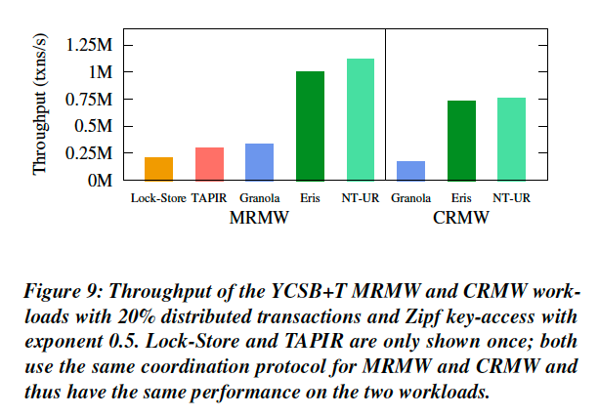
Throughput of YCSB+T

Slide 67
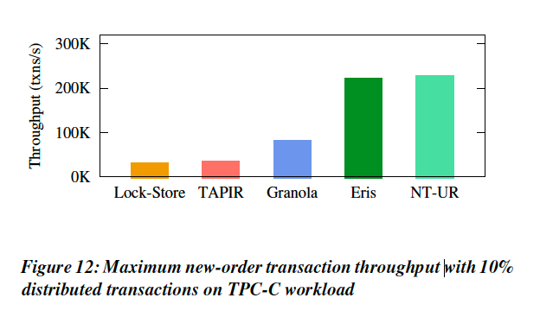
Throughput of TCP-C

Slide 68
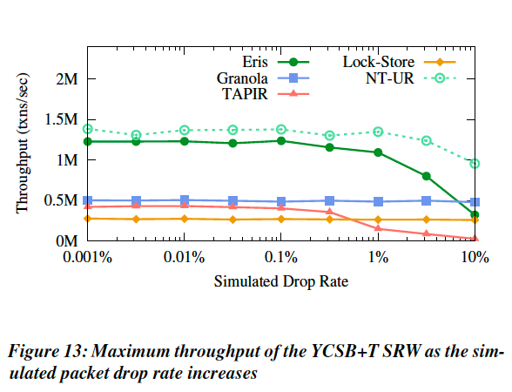
Network Resilience
Notes:
即使有很高的丢包率（1%），性能也只是减少10%。

Slide 69
Conclusion
•
A new division of responsibility for transaction processing
✤
An in-network concurrency control mechanism that establishes a consistent order of transactions across shards
✤
An efficient protocol that ensures reliable delivery of independent transactions
✤
A general transaction layer atop independent transaction processing
•
Result: strongly consistent, fault-tolerant transactions with
minimal performance overhead

